Slide 1
Tools & Patterns of Coding with Agentic AI
at the
Hack-a-thon for good

Slide 2
game rules changed
cost(start) ≈ 0

Slide 3
concept
Human in the loop

Slide 4
concept
Default AI Behaviors

Slide 5
CLAUDE.md
# Interaction
**ALWAYS** start replies with STARTER_CHARACTER + space (default: 🍀). Stack emojis when requested, don't replace.
**ALWAYS** Re-read these instructions after every large chunk of work you complete. When you re-read this file, say `♻️ Main rules re-read`
# Collaboration Guidelines
## Core Partnership
... - Take me with you on the thinking journey, don't just do the work. We work together to form mental models alongside the code we're writing. It's important that I also understand.
counters
chattiness
## Communication Style
- Be concise
- Keep details minimal unless I ask
- When you need to ask me several questions or give me a list of things, show me that list and then ask me
about each item one at a time
## Structure
I like ASCII diagrams on high level to talk about architecture of existing code or the code we're planning to write.
It helps me build high level understanding
Reinforce in prompts:
shorter,
TLDR,
higher level
counters
agreeableness &
compliance
## Mutual Support and Proactivity
This is EXTREMELY IMPORTANT:
- Don't flatter me. Be charming and nice, but very honest. Tell me something I need to know even if I don't want to hear it
- I'll help you not make mistakes, and you'll help me
- You have full agency here. Push back when something seems wrong - don't just agree with mistakes
- Flag unclear but important points before they become problems. Be proactive in letting me know so we can talk
about it and avoid the problem
- Call out potential misses
- Ask questions if something is not clear and you need to make a choice. Don't choose randomly if it's important for what we're doing
- When you show me a potential error or miss, start your response with❗️emoji
Reinforce in prompts:
do you have questions?
is anything unclar?

Slide 6
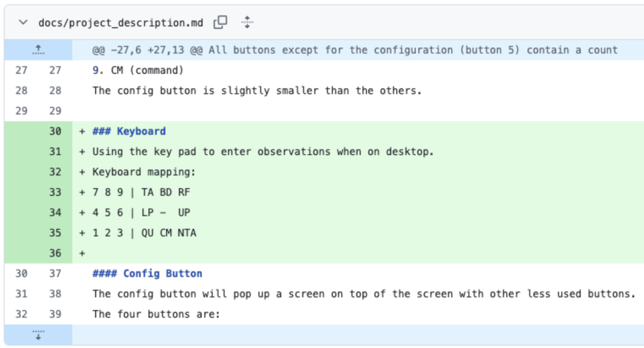
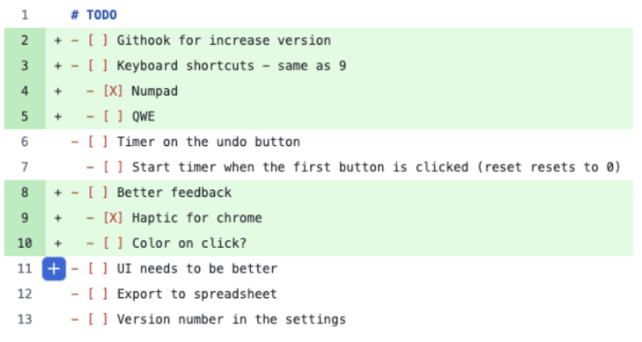
Growing Context: implementing keyboard shortcuts
growing context

Slide 7
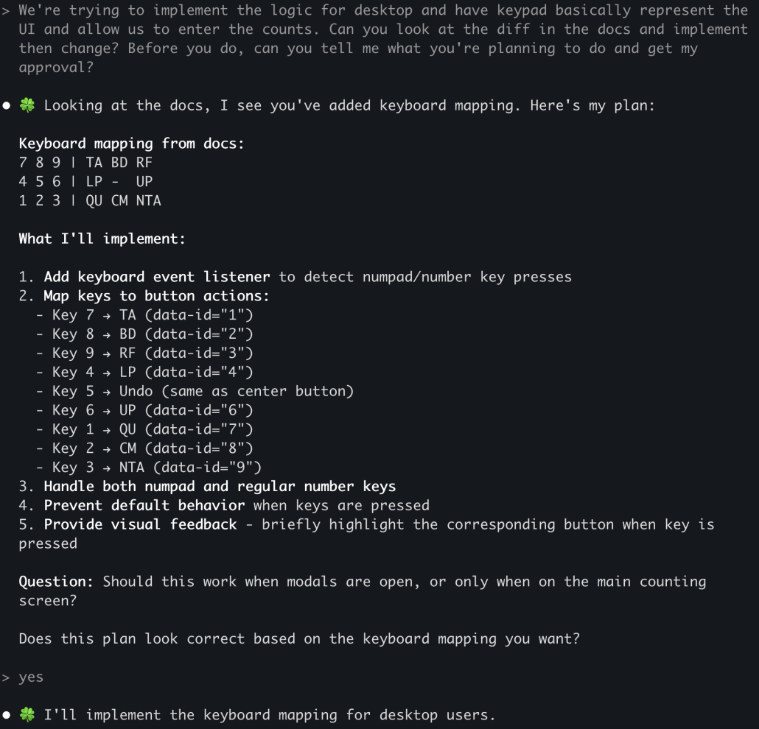
show me what you’re going to do before you do it

Slide 8

Reverse direction – mirror the ask
AI adopted PR model
Problem with PR model: it’s too late!
Additional problem with PR model with AI
Humans:
task -> ask questions -> do work -> create PR -> fix issues -> merge
AI:
task -> ask questions -> do work -> create PR -> fix issues -> merge
AI can’t do that by default!

Slide 9
Managing Context: extract knowledge back from AI
markdown
code

Slide 10
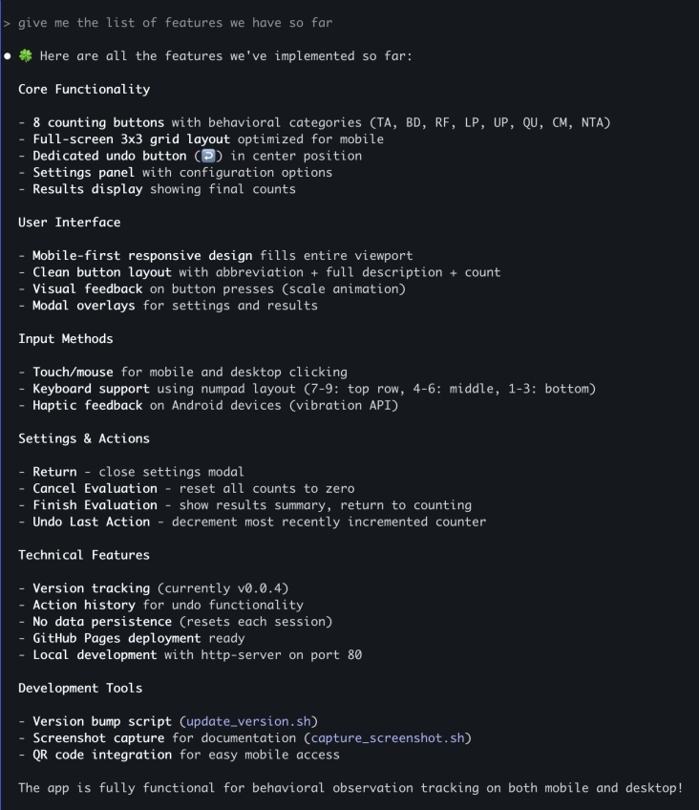
reverse direction
keep markdown focused

Slide 11
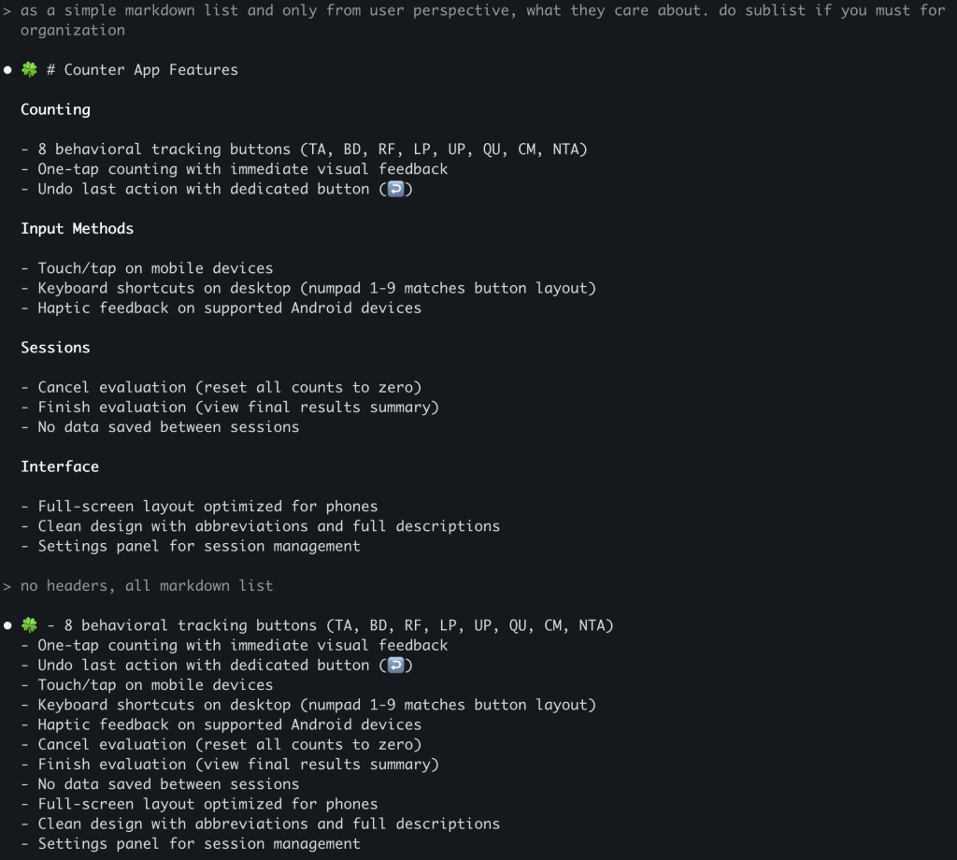
succinct

Slide 12
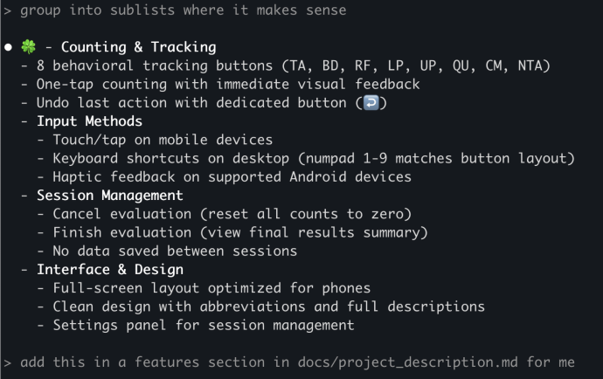
grow context

Slide 13
User Testing
Amanda notices that her child mirrored her counting stones
her good parenting techniques led to learning in her kid!
she noticed that the child said it back for the first time

Slide 14
concept
Squeeze non-determinism
out of your system

Slide 15
concept
Focus AI

Slide 16
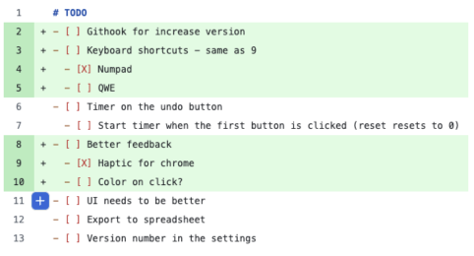
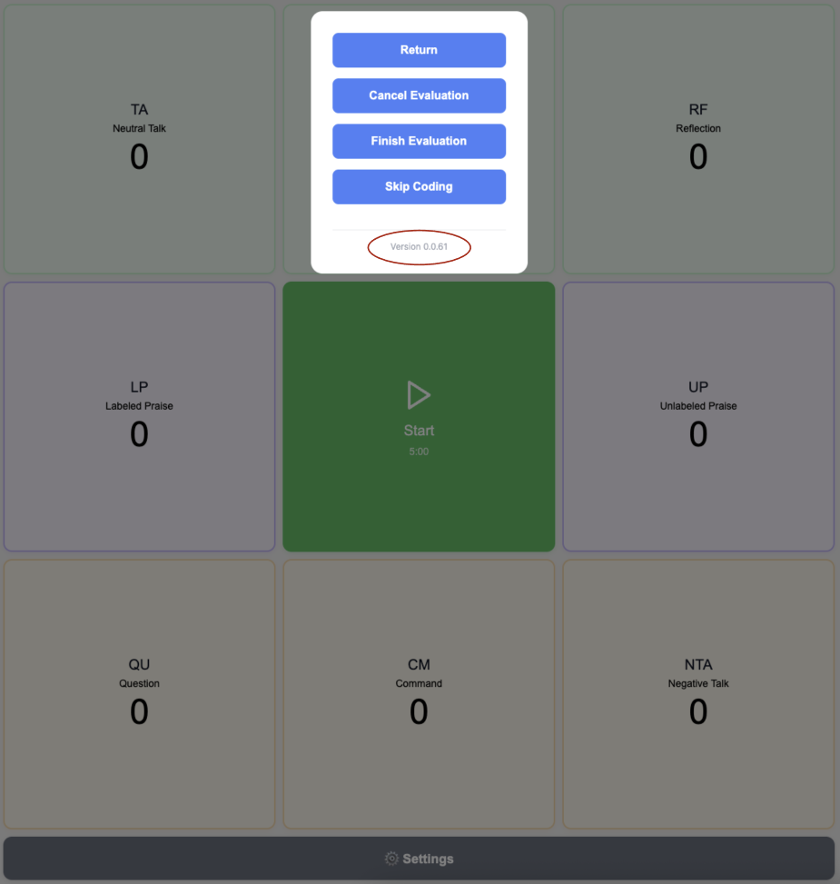
Squeeze non-determinism out of your system
squeeze non-determinisim out

Slide 17

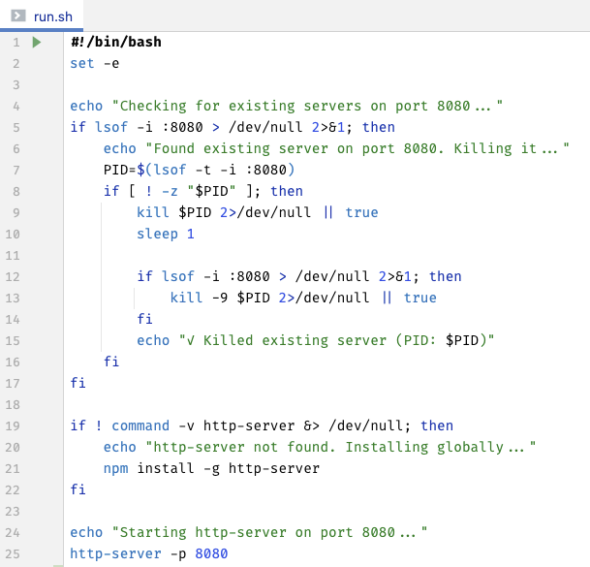
Script Everything
run.sh,
build_and_start.sh
Reduces mental load in humans
Saves tokens in AIs
squeeze non-determinisim out

Slide 18
concept
Custom Micro Tools
cost(start) ≈ 0

Slide 19
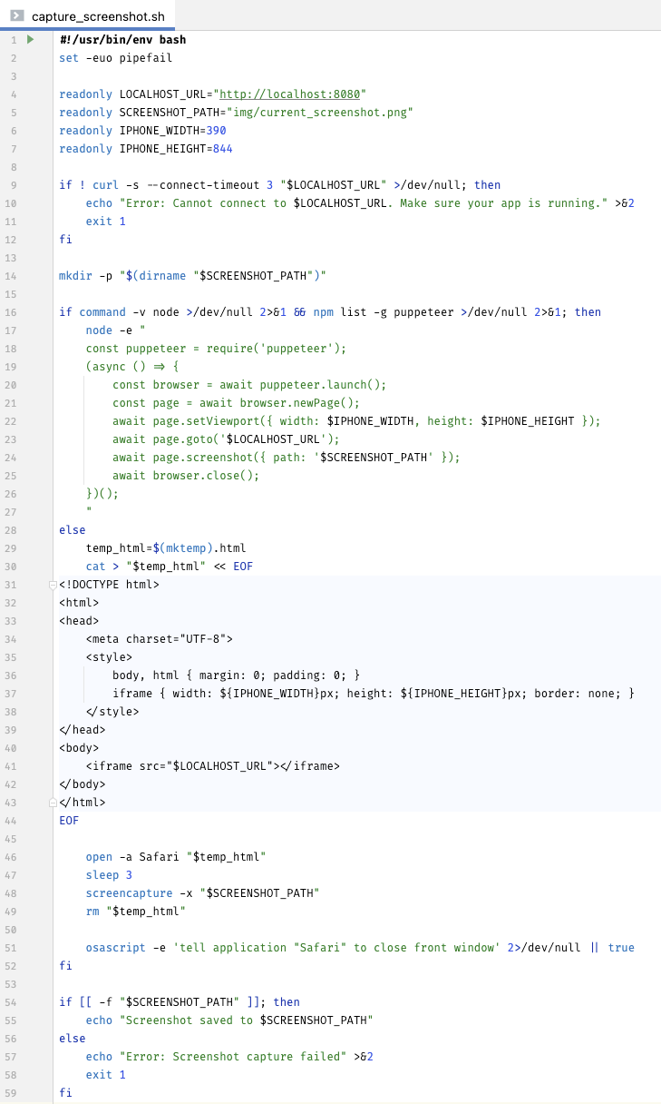
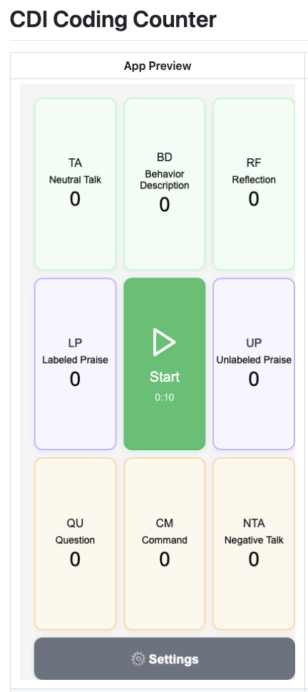
Screenshot Script

Slide 20
pattern
Get to Same Page ??

Slide 21
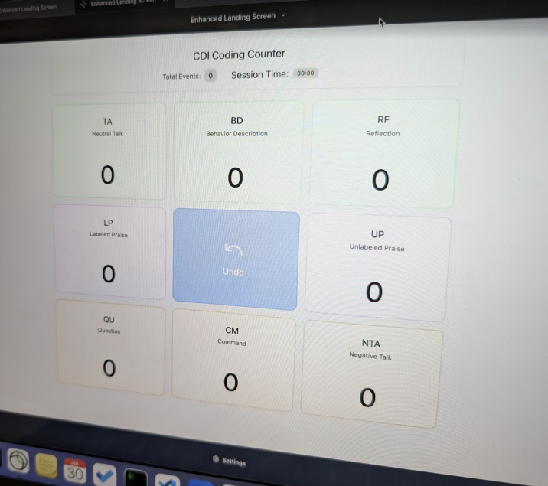
need before

Slide 22
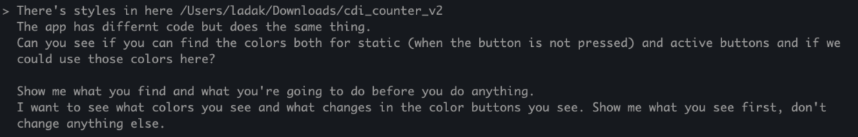
AI will fail system interviews
“Build Twitter”
Human (good case):
question 1
question 2
question 3
AI: “OK”
...
30 minutes later:
“I build you Twitter! Open localhost:80 to see it”

Slide 23
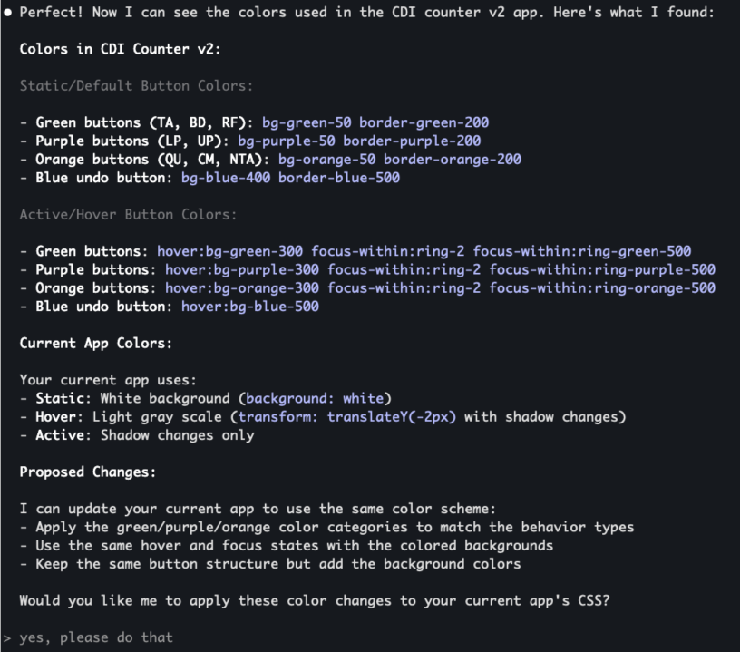

Slide 24
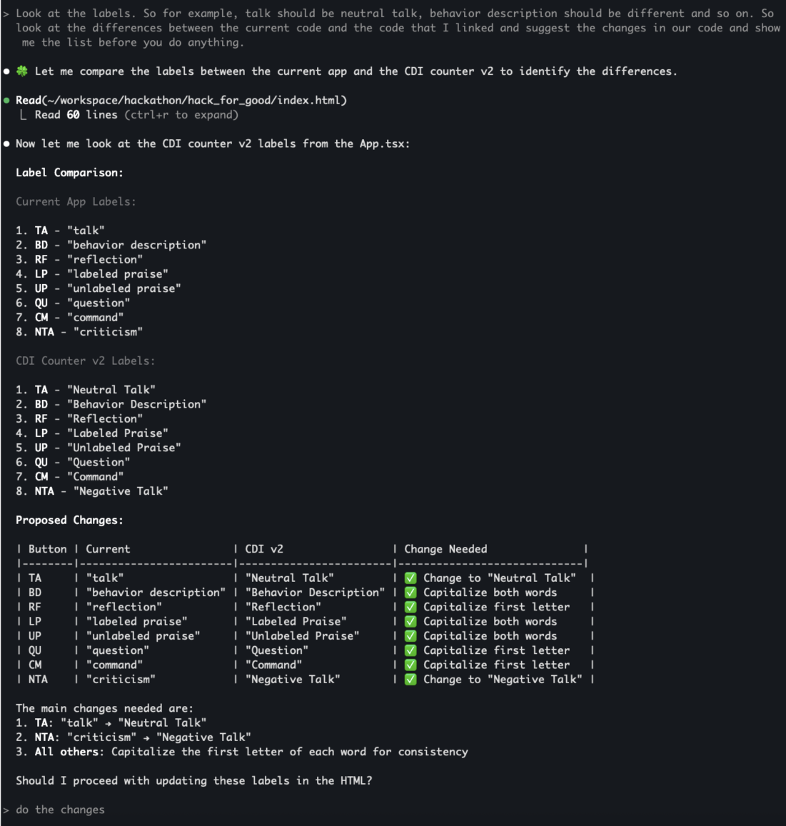

Slide 25
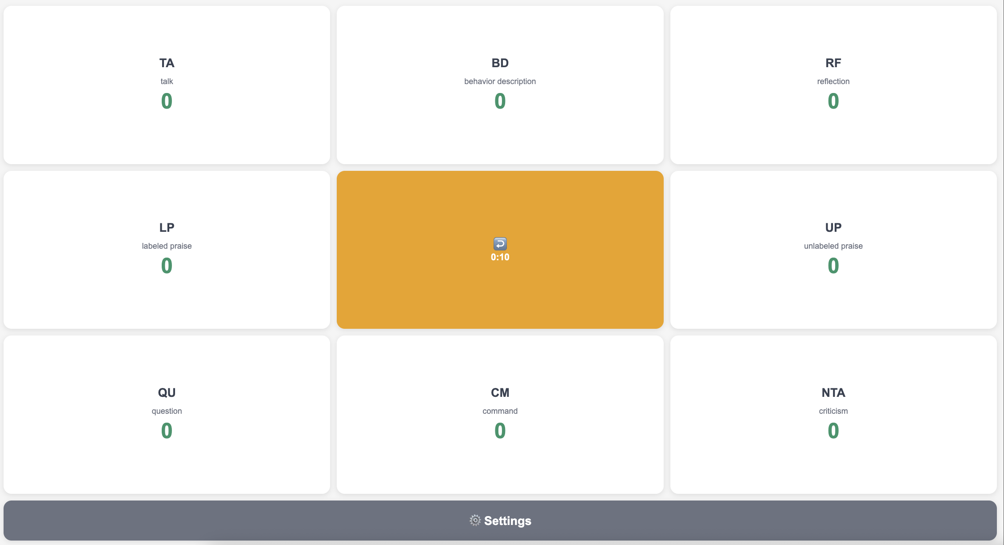
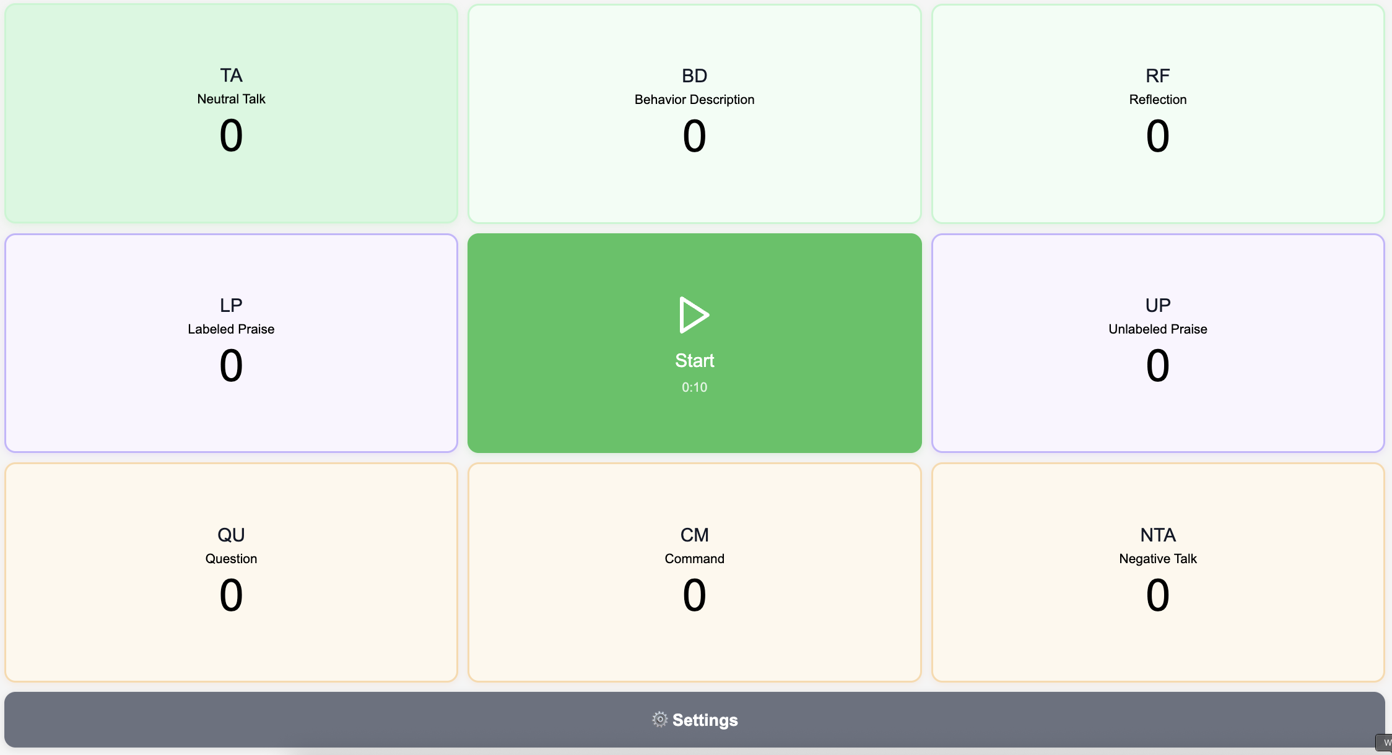
Before
After

Slide 26
pattern
Borrow Behaviors
use non-determinism as a feature!

Slide 27
Borrowed Behavior
Jordan –> zip file with design
ai
new ui
Main mob -> code
Wasn’t really possible before!

Slide 28
pattern
Diagraming in ASCII
default to text for everything

Slide 29
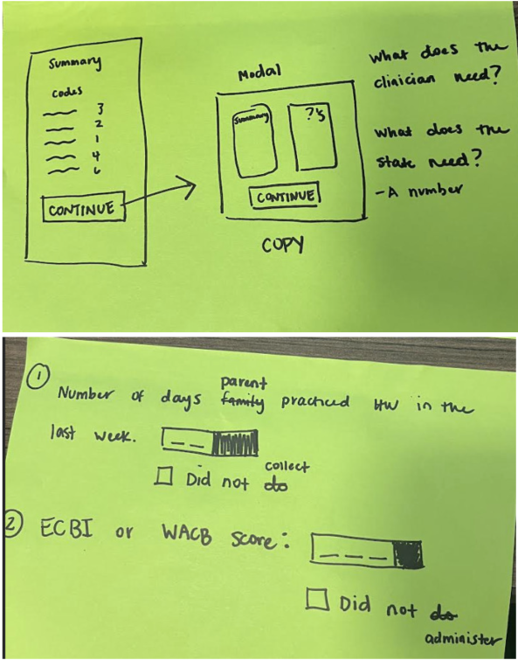

Slide 30
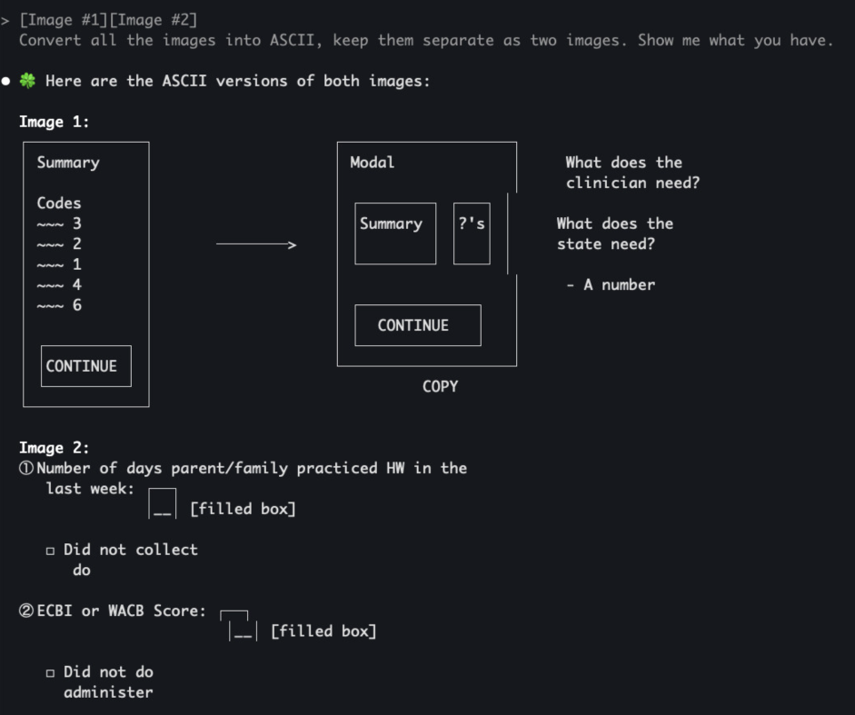

Slide 31
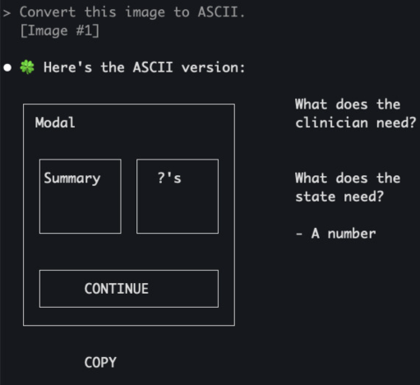
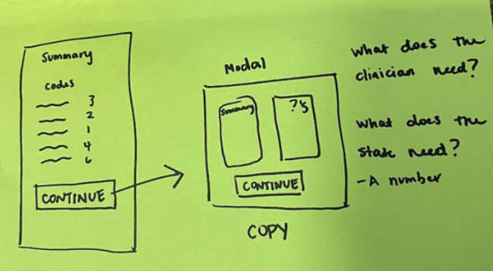

Slide 32
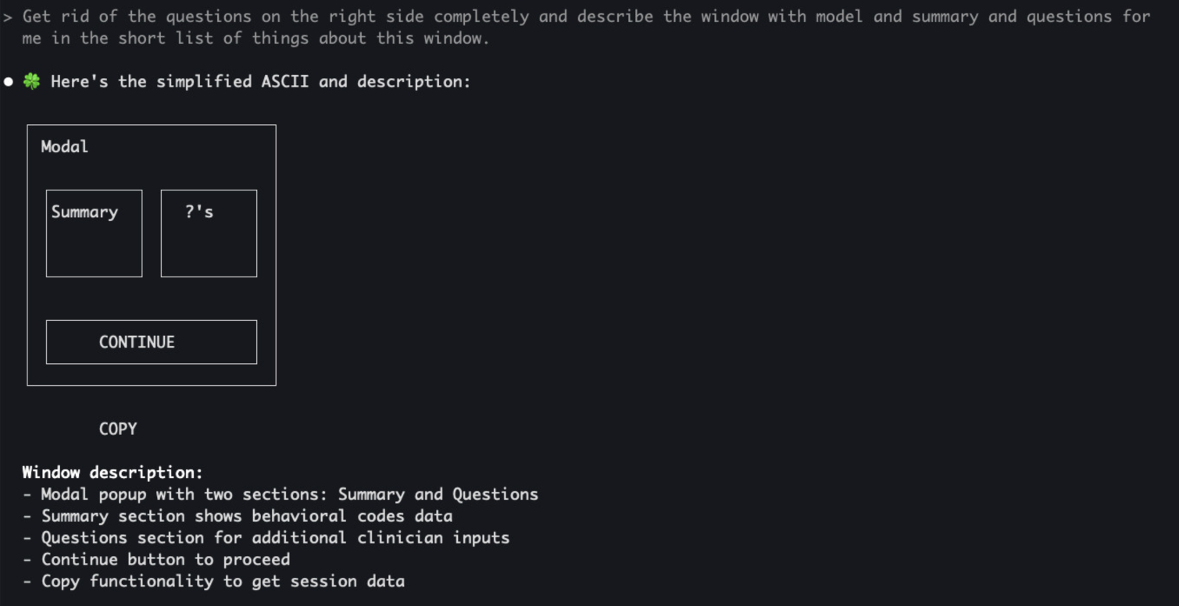

Slide 33
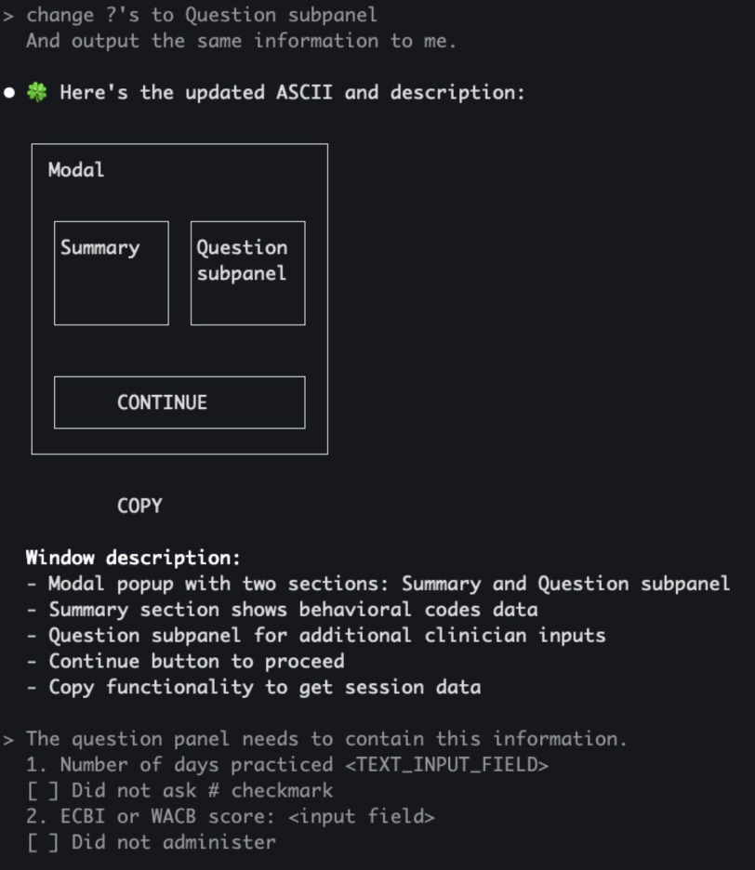

Slide 34
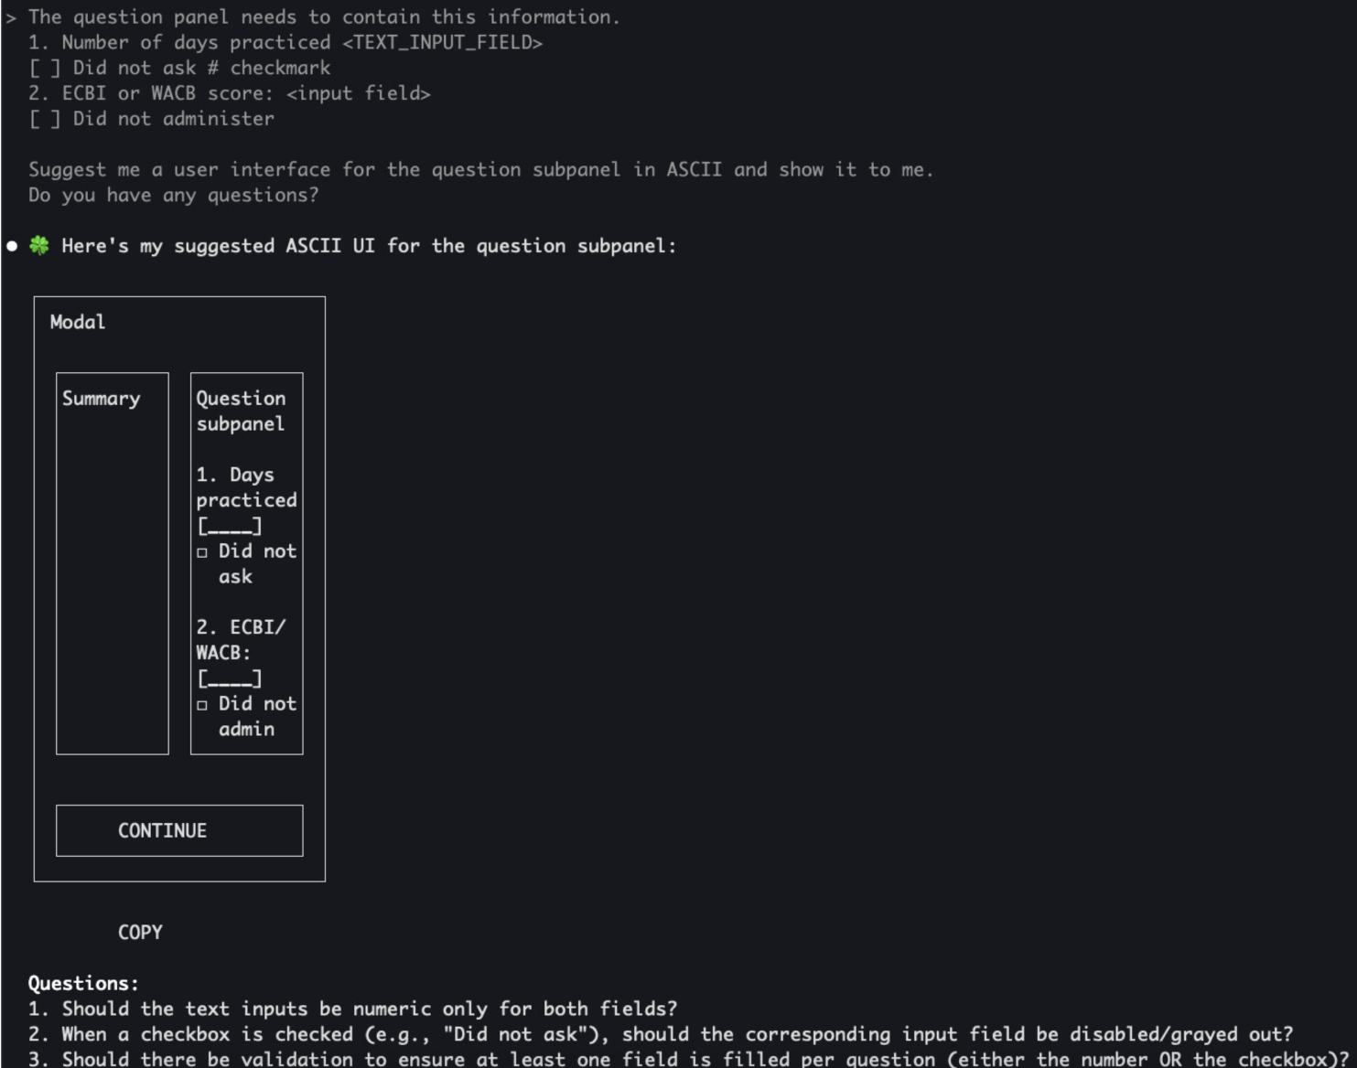

Slide 35
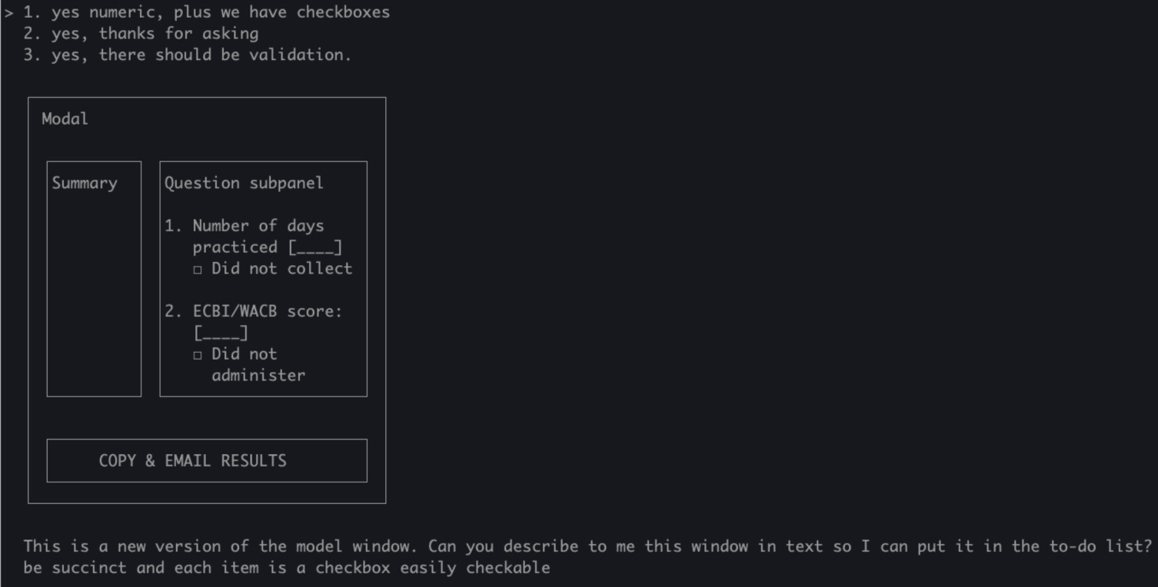
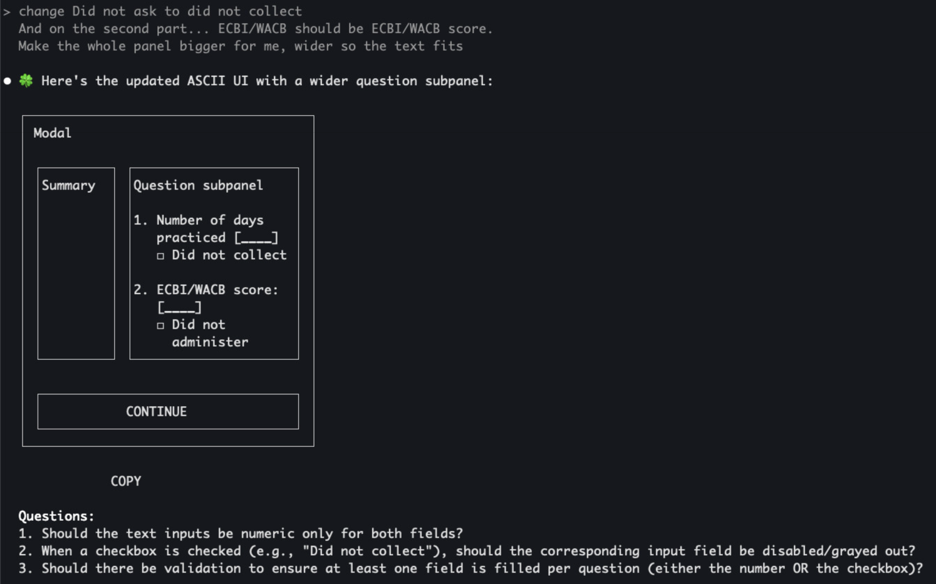

Slide 36
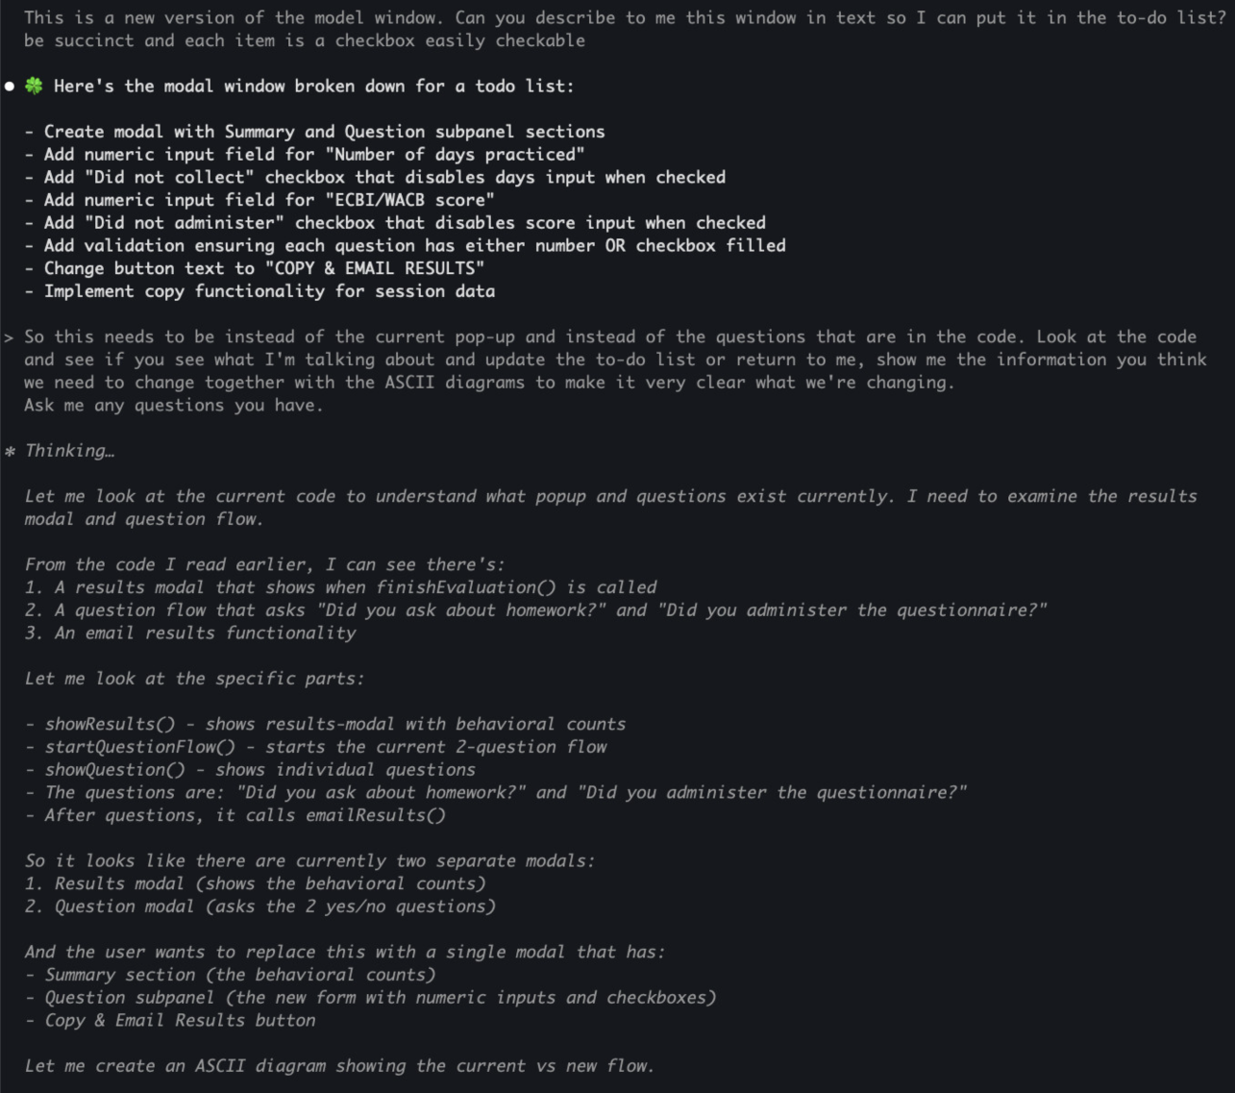

Slide 37
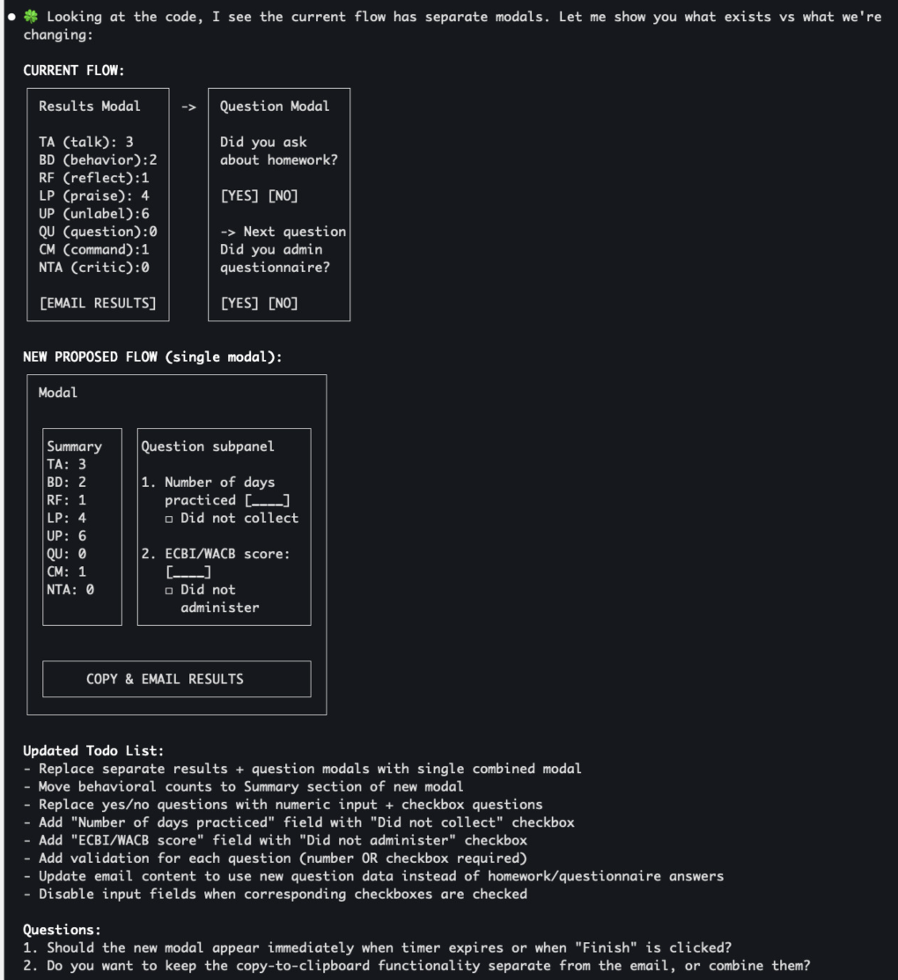

Slide 38
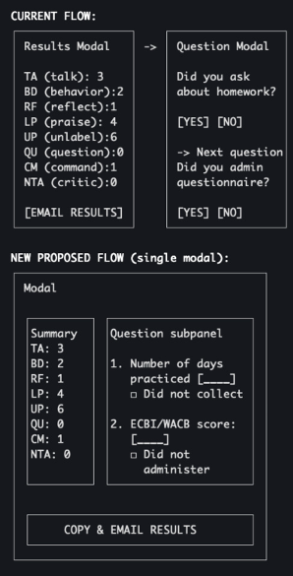
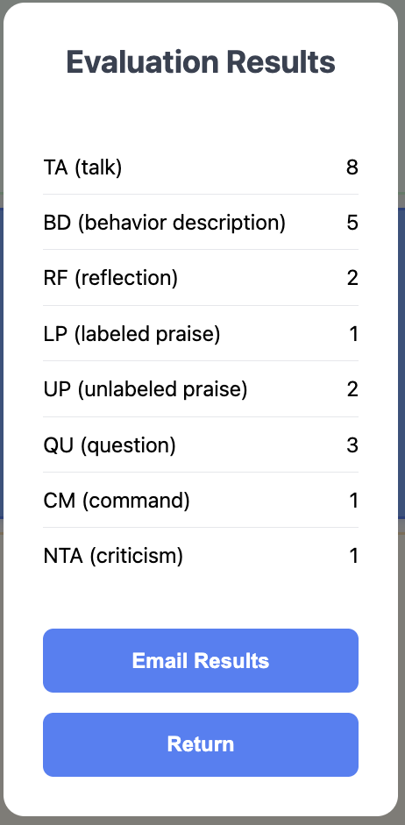
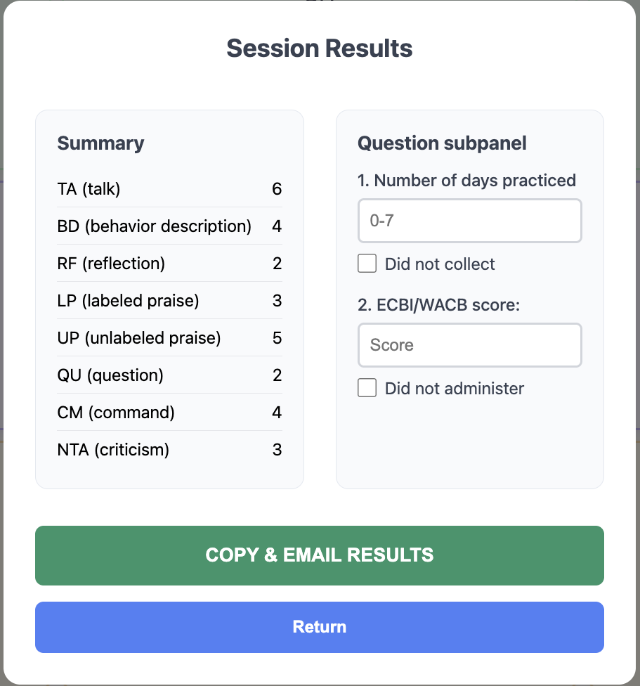

Slide 39
Human and AI Collaboration
Day 1: Working prototype
Day 2: Shaped most of data pipeline to state
Day 3: Refine, fix bugs, polish UI and help improve Excel tools, user doc
4 parallel mobs
contributing directly or providing inputs and designs to be used
some using Windsurf
some using Claude Code
delivered:
CDI coding counter - track child-parent interactions without looking away to catch crucial nuances
automated reporting to state
enhanced Excel analytics tools
complete user guide

Slide 40
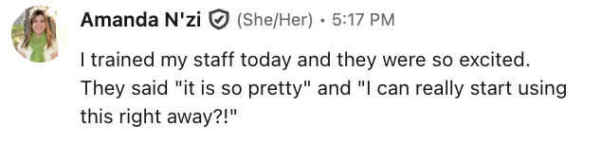
Results – same week
first data point!
excited users

Slide 41
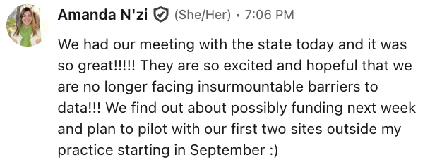

Results – next Tuesday
“Huge, great, what a successful initiative!... This is great, and I love how it sends that automatic email to you, Rachel, and bypasses PHI… I’m really impressed!”
– Noelle Smith, Colorado Department of Human Services
presented to state
real hope of funding
“I’m super impressed! I think the app is easy to use. I think rollout will be really easy… Sustainability will be really easy to manage and host.”
– Alysia Change, Colorado Department of Human Services
“I feel like we’re finally at a point where the barriers are going to be manageable."
– Dr. Amanda N'zi, Growing Together Child and Family Therapy, PLLC

Slide 42
Voice for Input and Output
if we have time

Slide 43
Reverse direction – broaden horizons

Slide 44
Get to the same page before starting work

Slide 45
- collaborate - agency and questions
- ensure understanding early
focus:
markdown, drop context, extract knowledge

